Slide 1
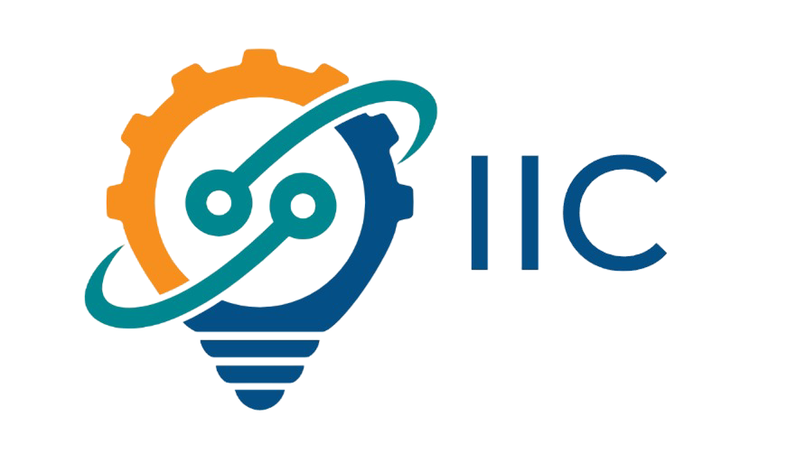


IIC
INDIA
INNOVATION
CENTER
www.indiainnovationcenter.com
NAME - AALOK KUMAR SINGH
ROLL NO - 2401201185
PROJECT - INNOHUB
COURSE - BCA (AI &DS)

Slide 2

Overview
Introduction
About Us
Problem Statement
Our Objectives
Key Features
Methodology
Screenshots
Conclusion & Future Work
01
02
03
04
05
06
07
08

Slide 3


Introduction
The India Innovation Center (IIC) is a visionary initiative aimed at nurturing startups by providing essential support in funding, mentorship, and research. Designed with AI-powered tools and a collaborative framework, IIC bridges the gap between innovation and implementation—empowering entrepreneurs, researchers, and stakeholders across India to build solutions for tomorrow.

Slide 4

IIC
About Us
The India Innovation Center (IIC) is a platform designed to foster entrepreneurial growth and technological innovation across India. It provides startups with mentorship, funding, collaboration tools, and research support, while connecting government bodies, investors, academia, and corporate partners. By leveraging AI and modern web technologies, IIC accelerates and streamlines the innovation journey for Indian entrepreneurs.
A TECH-DRIVEN INNOVATION HUB EMPOWERING INDIAN STARTUPS THROUGH AI, RESEARCH, FUNDING, AND STRATEGIC PARTNERSHIPS.

Slide 5


Problem Statement
INDIA’S STARTUP ECOSYSTEM OFTEN FACES CHALLENGES LIKE FRAGMENTED SUPPORT SYSTEMS, LIMITED ACCESS TO FUNDING, LACK OF MENTORSHIP, AND WEAK COLLABORATION BETWEEN GOVERNMENT, INDUSTRY, AND ACADEMIA. THERE IS A NEED FOR A UNIFIED PLATFORM TO BRIDGE THESE GAPS AND ACCELERATE INNOVATION.

Slide 6




Our Objectives
To empower and accelerate the growth of Indian startups by providing a unified digital ecosystem that fosters innovation, facilitates access to funding and mentorship, and connects entrepreneurs with government, academia, and industry partners.
01
02
03
04
DRIVE DIGITAL TRANSFORMATION
BRIDGE ECOSYSTEM GAPS
PROMOTE INCLUSIVE GROWTH
FOSTER INNOVATION:

Slide 7


Methodology
Platform Development: Built using WordPress with custom themes and plugins for flexibility and scalability.
AI Integration: Leveraged Hostinger AI tools for content generation, optimization, and smart automation features.
Hosting: Deployed on Hostinger for reliable and high-speed web hosting.
Design Tools: Utilized WordPress page builders (e.g., Elementor or Gutenberg) for a responsive and user-friendly interface.
Collaboration & Testing: Used built-in WordPress collaboration tools and third-party plugins for user interaction and testing.

Slide 8


Key Features
ONBOARDING
The India Innovation Center (IIC) provides AI-driven onboarding, personalized startup guidance, and access to investment opportunities. We offer research, prototyping support, and foster collaboration with government and industry leaders to help startups grow and succeed.
AI-driven startup onboarding and guidance
INVESTMENT
Investment discovery platform
COLLABORATION
Government and industry collaboration framework

Slide 9

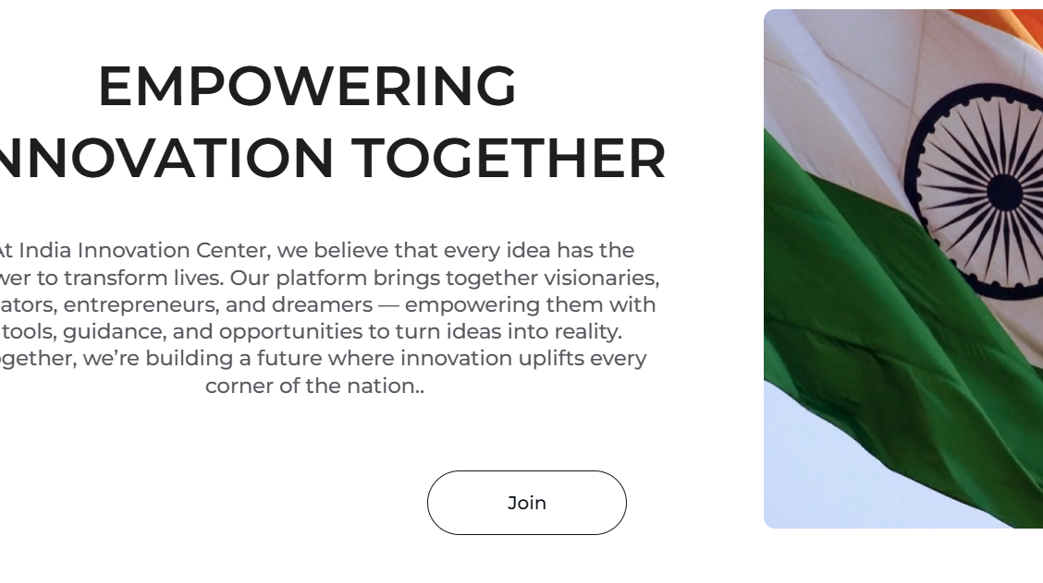
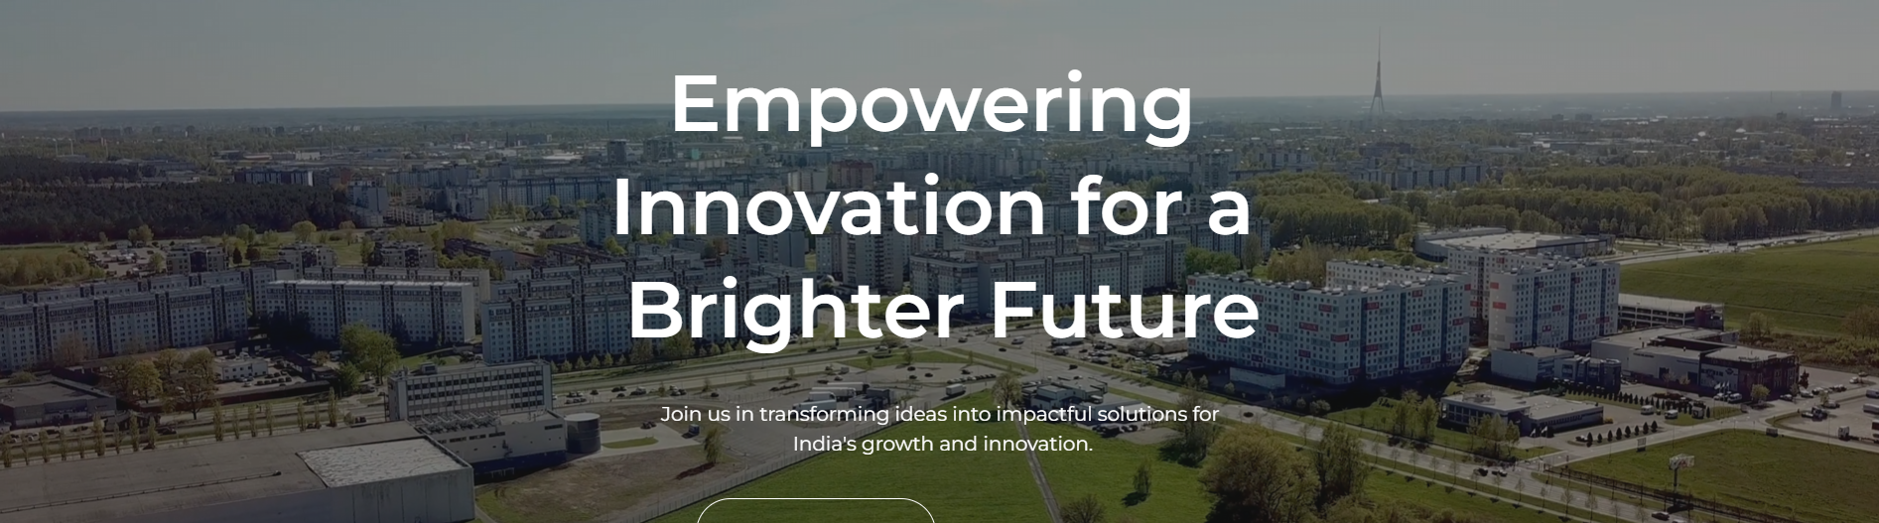
SCREENSHOTS

Slide 10

Conclusion & Future Work
The India Innovation Center aims to be a game-changer in the startup landscape by integrating technology, mentorship, and ecosystem partnerships into one seamless platform.
Future Work:
Expand AI capabilities for deeper analytics and startup insights
Add regional language support for greater accessibility
Launch mobile app for on-the-go access
Develop training modules and certification programs for entrepreneurs
Claudia Alves
Olivia Wilson

Slide 11
IIC
THANK TOU
For watching this presentation

